Slide 1
Securing SQL Server
Recommended Practices & Fundamentals

Slide 2
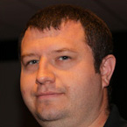
About Me
John Q Martin
Solutions Engineer – SentryOne
Twitter : @SQLDiplomat
Email : jmartin@sqlsentry.com
Blog : http://blogs.sqlsentry.com/author/JohnMartin
Over a decade of experience with SQL Server
DBA
Dev
BI
Worked for Microsoft as a Premier Field Engineer (PFE) in the UK

Slide 5
Agenda
Physical Security
SQL Server Configuration
Database Design
Key Principals
OS Configuration
Database Configuration

Slide 6
Key Principals
Defence In Depth

Slide 7
Key Principals
Threats exist in many places
Accidental disclosure
Understand the scope

Slide 8
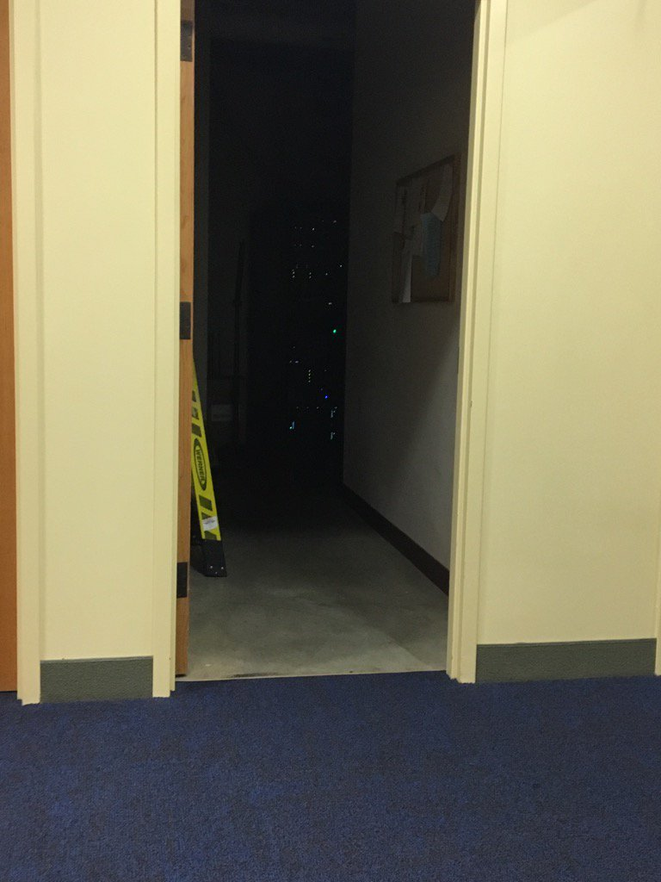
Physical Security
More than locked doors
Transportation of data
ACLs and Logs
Notes:
Image Source : Erin Stallato [SQL Skills] – Public Library in US state of Ohio

Slide 9
Operating System Configurations
File System ACLs
Backup & File Locations
Windows Firewall
Restrictive Policies
Information Leakage considerations
Notes:
Windows Firewall
-----------------------------
SQL Server Configuration - https://msdn.microsoft.com/en-us/library/cc646023.aspx
SSRS Configuration - https://msdn.microsoft.com/en-gb/library/bb934283.aspx
SSIS Configuration - https://msdn.microsoft.com/en-us/library/ms137861.aspx
SSAS Configuration - https://msdn.microsoft.com/en-GB/library/ms174937.aspx

Slide 10
SQL Server Configurations
Appropriate Service Accounts
Compartmentalize
Managed Service Accounts

Slide 11
Managed Service Accounts
Managed Service Account (MSA)
SQL Server 2012+
Group Managed Service Account (gMSA)
SQL Server 2016 +
Domain Functional Level 2008 or above
One server per-MSA
Domain Functional Level 2012 or above
Multiple Servers per-gMSA
No Interactive Logon
No Password
Auto Password Rotation
SPN Management
Notes:
Managed Service Accounts – SQL Server 2012
-------------------------------------------------------
https://blogs.msdn.microsoft.com/arvindsh/2014/02/03/managed-service-accounts-msa-and-sql-2012-practical-tips/
Service Account Recommendations
---------------------------------------------
https://msdn.microsoft.com/en-us/library/ms143504.aspx

Slide 12
Compartmentalized Account Structure
Scope of Risk

Slide 13
Compartmentalized Account Structure
Scope of Risk

Slide 14
Compartmentalized Account Structure
Scope of Risk

Slide 15
SQL Server Configurations
Appropriate Service Accounts
Compartmentalize
Managed Service Accounts
Encrypt Connections
TLS/SSL
IPsec

Slide 16
SQL Server Configurations
Role based security
Server Roles
T-SQL Stored in Source Control
Avoid the use of SysAdmin where possible
SQL Server Agent
Use Proxies and Credentials
Compartmentalize

Slide 17
Database Configurations
Low Privilege Owner
Database Containment
Avoid Setting Trustworthy

Slide 18
Demo
Why you should not always trust your databases

Slide 19
Database Configurations
Transparent Database Encryption
Protect files at rest
Backups Encrypted
SQL Server 2016/Azure SQL DB
Row Level Security
Dynamic Data Masking
Always Encrypted

Slide 20
Demo
Using Transparent Data Encryption

Slide 21
Database Design
Security by design
Part of the schema
In source control
Key Concepts
Database Roles
Execute As
Explicit Permissions
Notes:
SQL Injection Protection
---------------------------------------------
Mladen Prajdic (MVP) : Great resources and a great guy. Recommend you attend his sessions as they are really informative and has fantastic delivery.
Twitter : @MladenPrajdic (http://twitter.com/MladenPrajdic)
Web : http://www.ssmstoolspack.com/
Sessions to watch
-----------------------
SQL Server and Application Security for Developers - http://slideplayer.com/slide/6418730/
SQL Server and Application Security for Developers - http://www.sqlsaturday.com/376/Sessions/Details.aspx?sid=24797 (Slides and Demo Code)

Slide 22
Database Design
Limit Table Access
Views
Stored Procedures
Encrypted Data?
Cipher text Vs Clear text

Slide 23

Questions

Slide 24
Thank You!
Have a great event, session content available on GitHub.
https://github.com/johnqmartin/Community-Sessions

